Slide 1
Breast Cancer Classification in Treatment Stages
Supervised by
Dr. Sabah Elsayed
TA. Huda Ahmed
Implemented by
20178001 Ibrahim Adel
20188056 Haidy Ali
20188011 Eman Mostafa

Slide 2
Agenda
Project idea
Dataset
Problem significance and our solutions
Project specifications
Time Plan
Conclusion
Future Work
Demo

Slide 3
Project idea
Why we choose breast cancer?
Breast cancer is one of the most dangerous diseases that women face, with the greatest mortality rate.

Slide 4
About Project
The project is a website working on cancer classification.
The aim of this project is to use image processing and machine learning techniques to analyze a CT scan to study the effect of chemotherapy on a patient.

Slide 5
The domain of interest
Project interested in oncology whereas this project is directed to doctors and specialists in radiology laboratories.

Slide 6
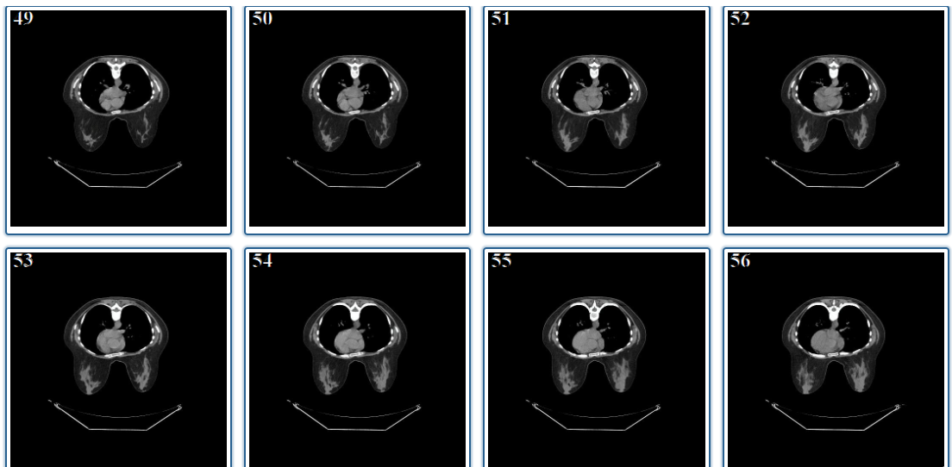
Dataset
What about the data we use?
We use QIN-Breast data from The Cancer Imaging Archive (TCIA).
This data divided into three stages of treatment.

Slide 7
Dataset passed through three phases
Choosing CT images from QIN-Breast.
Taking clearest images sample.
Image Processing.

Slide 8
Choosing CT images from QIN-Breast
Collection Statistics​ | Before Filtering​ | After Filtering​
Modalities​ | MR, PET, CT​ | CT​
Number of Participants​ | 68​ | 31
Number of Images​ | 100,835​ | 7553
Number of Studies​ | 214​ | 91
Number of Series​ | 530 | 91

Slide 9
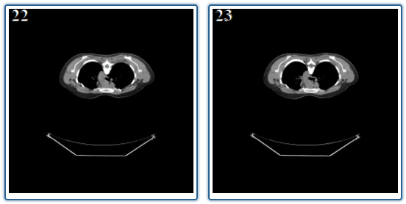
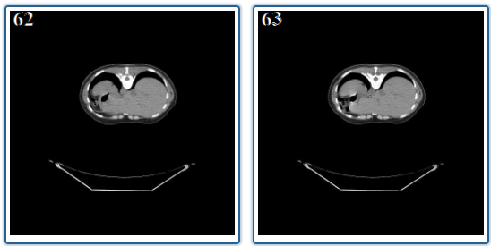
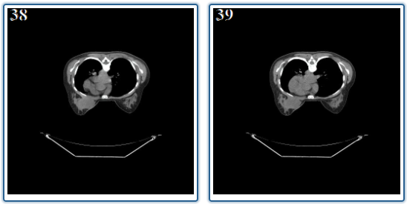
Taking clearest images sample
Collection Statistics​ | Old Dataset | New Dataset
Number of Participants​ | 31 | 31
Number of Images​ | 7553 | 930
Number of Images in each Studies​ | 83 | 10
Number of Images for each Patient | 249 | 30

Slide 10
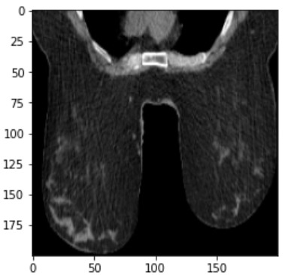
Image Processing
Convert CT images from Dicom files to JPG files.
Crop CT images.
Resize CT images to 200 * 200.

Slide 11
Problem Significance
What is the problem we are going to solve?
The project help in study the effect of chemotherapy precisely enough in different stages of treatment.

Slide 12
Why we going to solve this problem?
In order to make it easier for doctors and specialists to know more details about the patient and chemotherapy during the different stages of treatment.

Slide 13
How we solved this problem?
By creating two samples of data:
Dataset contain 30 CT images for each patient.
Dataset contain 15 CT images for each patient.
Implement CNN models using two datasets and compare the accuracies.
Trying different methods in our CNN models.

Slide 14

Methods in CNN models
Traditional CNN models
Problems with this method:
Overfitting.

Slide 15
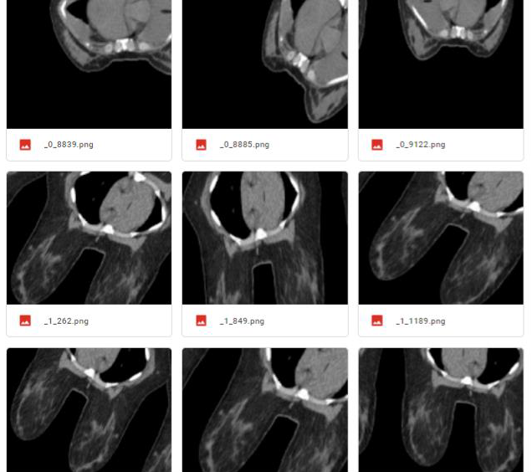
CNN Models with data augmentation
Improvements in this method:
Solved overfitting problem.
Problems with this method:
Accuracy not good enough
to approve.

Slide 16
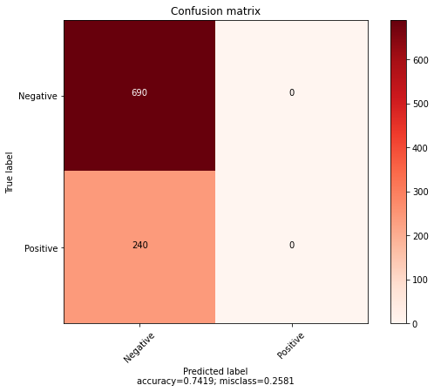
CNN Models with Cross-Validation
Problems with this method:
Overfitting.
Don't select any positive values.

Slide 17
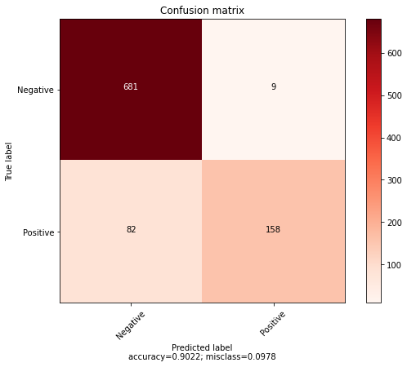
CNN Model with categorical labels
Improvements in this method:
Select any positive values.
Improve the accuracy.
Problems with this method:
The f1-score for positive
class is low.

Slide 18
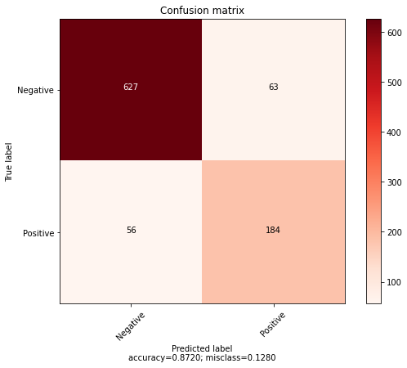
CNN Models with balanced weights
Improvements in this method:
Accuracy is good.
Problems with this method:
Still a big difference in
f1-score between two classes.

Slide 19
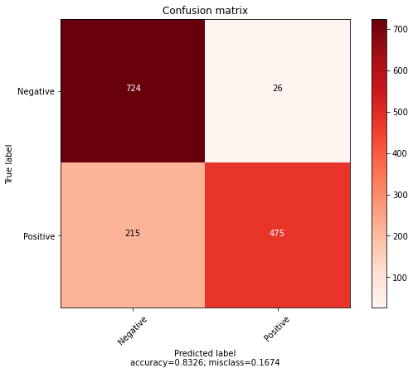
CNN Model with SMOTE
Improvements in this method:
Solved the problem of difference in f1-score between two classes.
Accuracy is good.

Slide 20
Previous solutions to the problem
Prediction of pathological complete response to neoadjuvant chemotherapy in breast cancer using a deep learning (DL) method. (PMID: 31944571)
Multi-input deep learning architecture for predicting breast tumor response to chemotherapy using quantitative MR images. (PMID: 32556920)

Slide 21
Advantages
These projects predict the impact of neoadjuvant therapy in tumor.
Which is the same objective of our project.

Slide 22
Disadvantages
These projects used DCE-MRI images which need specific devices to capture it which may not able in all radiology laboratories.
The data used in these projects not divided into stages in the treatment.

Slide 23
Project specifications
Functional Requirements
Registration.
Login.
Upload images as CT scans.
User get result as PCR or nonPCR.
Non-functional Requirements
Usability
Scalability

Slide 24
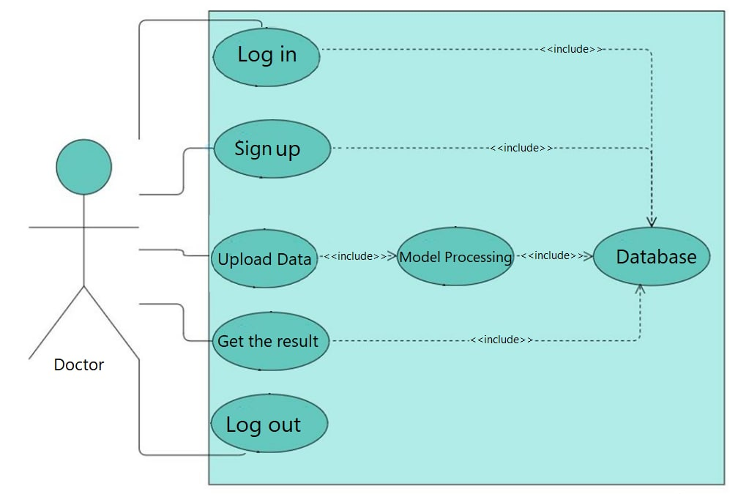
Use-Case Diagram

Slide 25
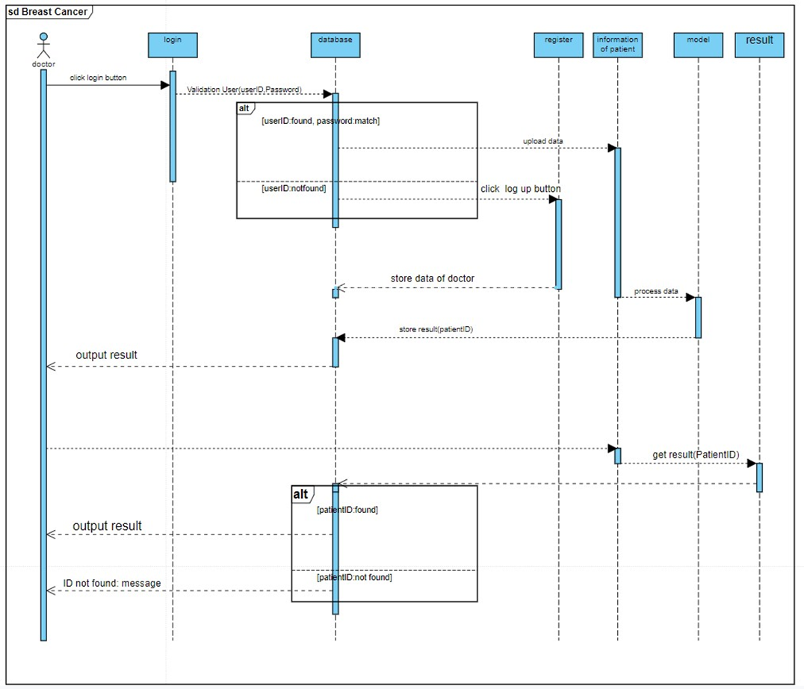
Sequence Diagram

Slide 26
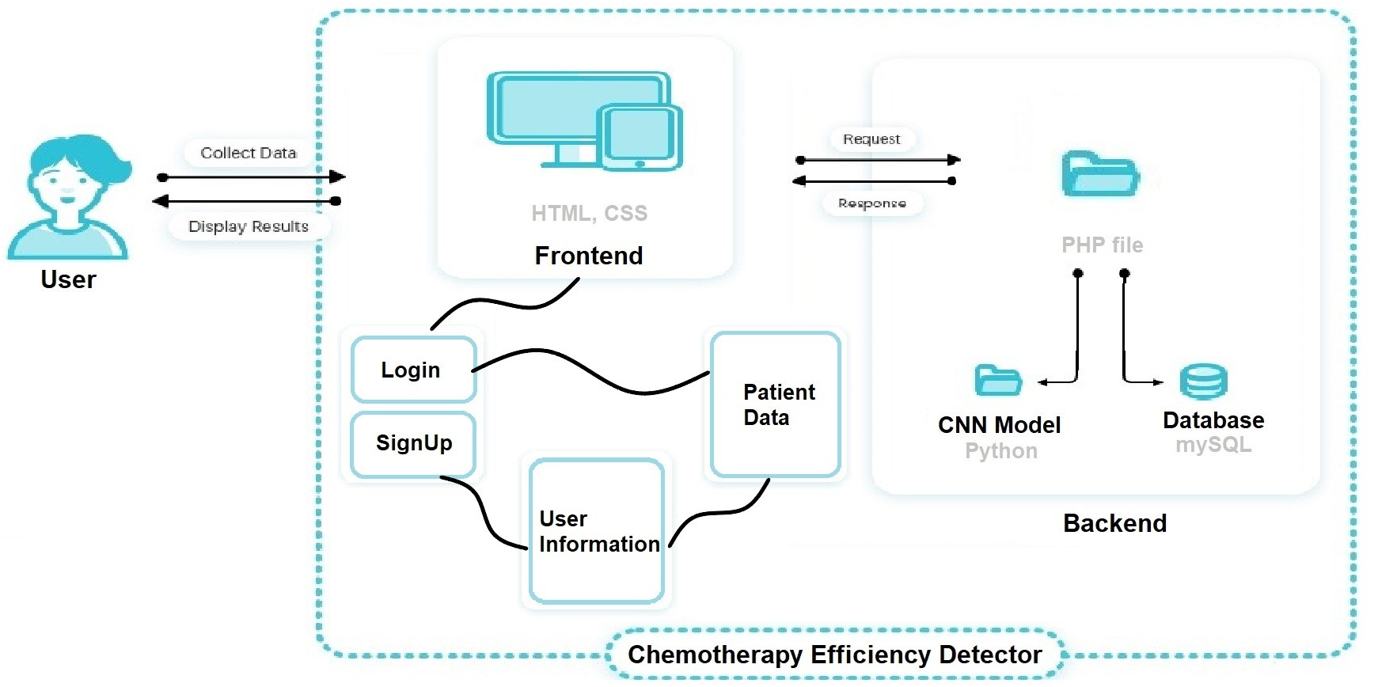
System Architecture
We have two main components in our system

Slide 27
Frontend
User interface created by HTML and CSS.
That interface split into three HTML pages:
SignUp or Login page.
User page.
Patient data page.

Slide 28
Database
Database created by MySQL.
That database contains two main tables:
User table.
Patient table.

Slide 29
Backend
Web Application backend uses PHP and Python:
PHP to connect HTML pages with database and Python script.
Python for patient data processing

Slide 30
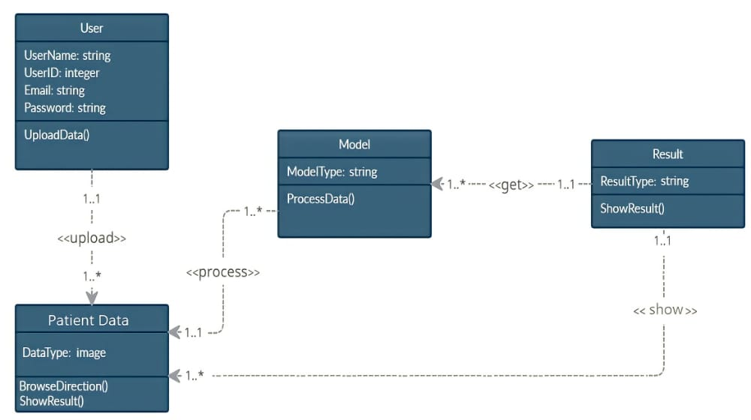
Class Diagram

Slide 31
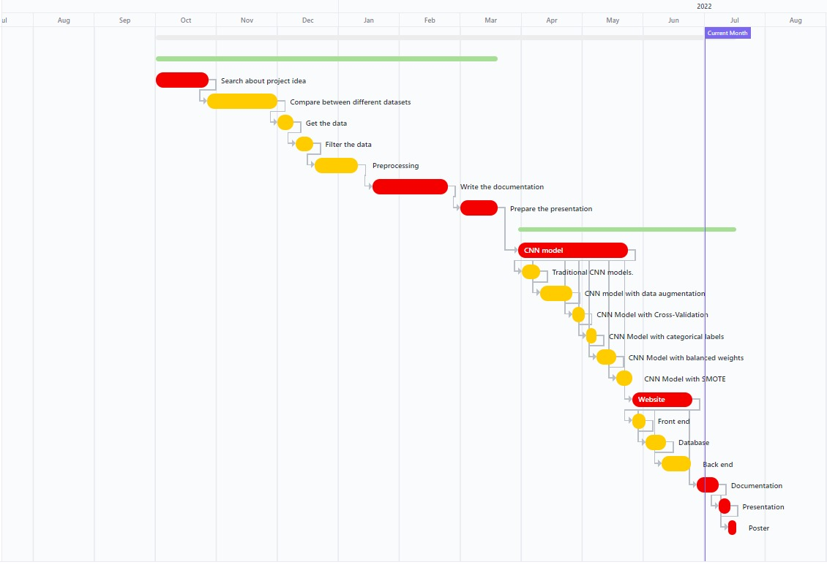
Time Plan

Slide 32
First 4 Months
1. Search about project idea
2. Compare between different datasets
3. Get the data
4. Filter the data
5. Preprocessing
6. Write the documentation
7. Prepare the presentation

Slide 33
Second 4 Months
1. CNN model
Traditional CNN models.
CNN model with data augmentation.
CNN Model with Cross-Validation.
CNN Model with categorical labels.
CNN Models with balanced weights.
CNN Model with SMOTE.
2. Website
Front end.
Database.
Back end.
3. Write the final documentation.
4. Prepare the final presentation.
5.poster

Slide 34
Conclusion
What our project working on
Knowing if chemotherapy effective on patient or not by:
CNN model done with SMOTE and data augmentation methods by 83% accuracy.
Using simple Web Application based on these CNN model that contain three HTML pages:
SignUp or Login page, User page and Patient data page.
What our project aspire to
Our project can be a seed for other projects in the future that will help us and facilitate making a decision on chemotherapy.

Slide 35
Future Work
In website:
Making UserId automatically created in registration.
Making user pick the location of folder rather than write the path.
In database:
Adding update function.
Saving patient images and use it in model.

Slide 36

Demo

Slide 37
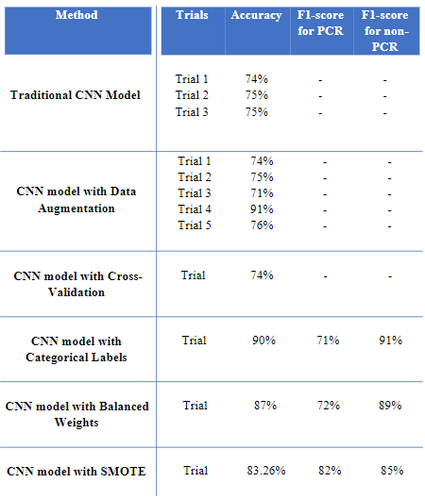
Results Summary

Slide 38
Thank You Any Questions?!

